Slide 1
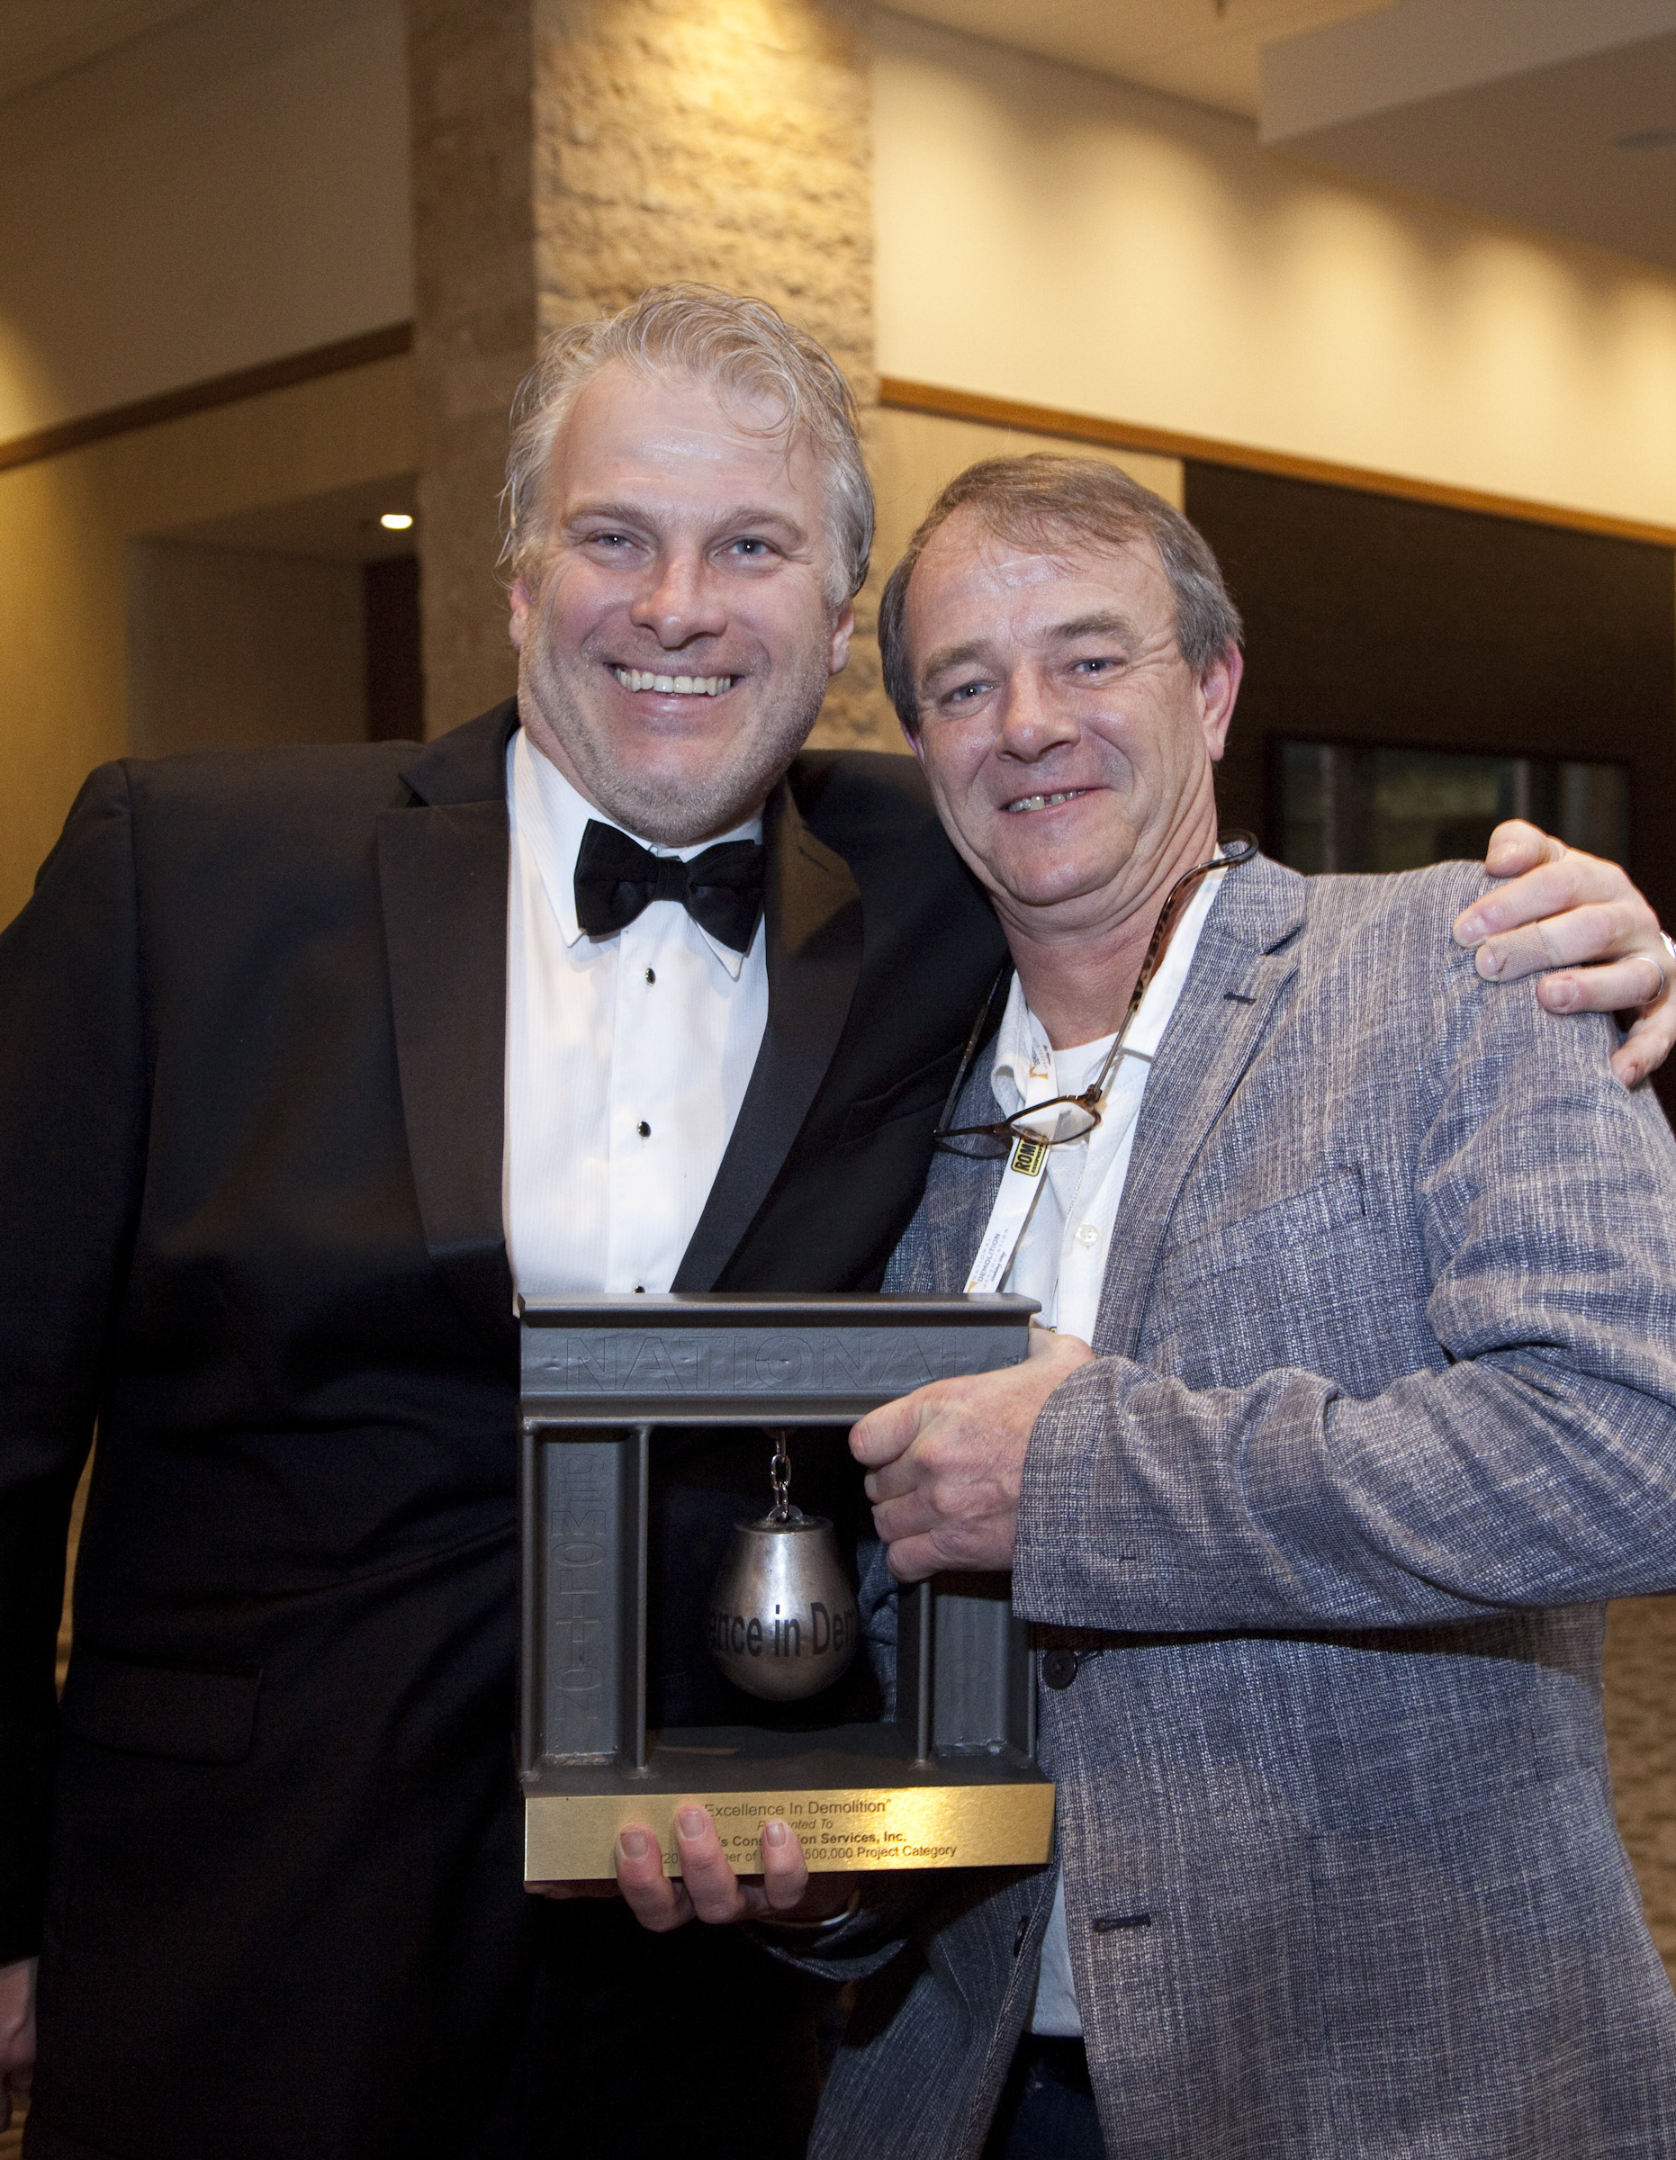
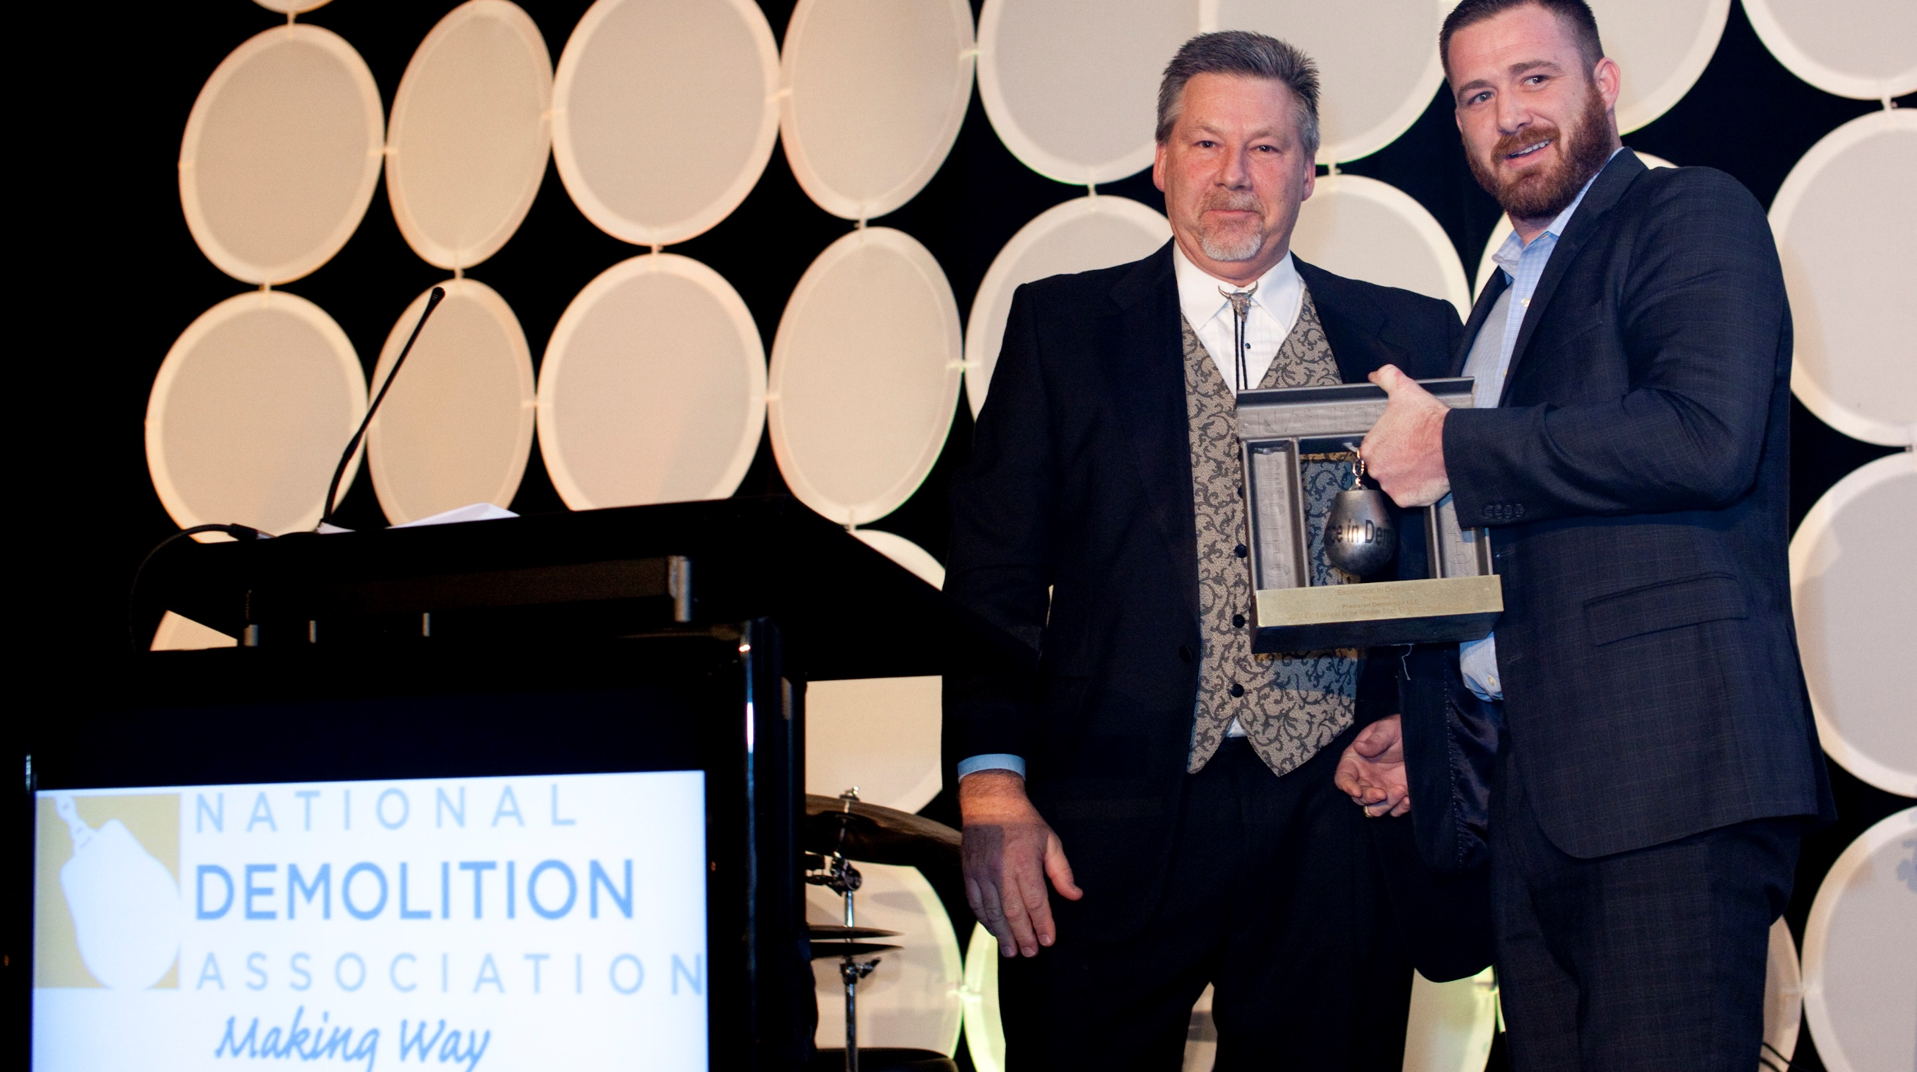
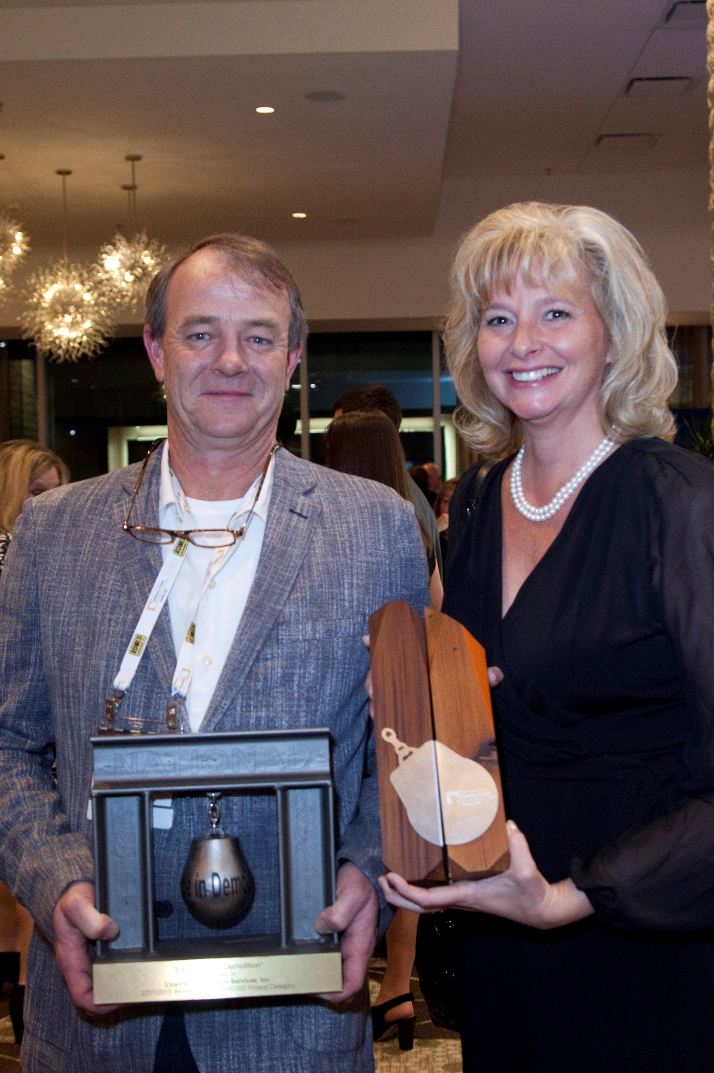
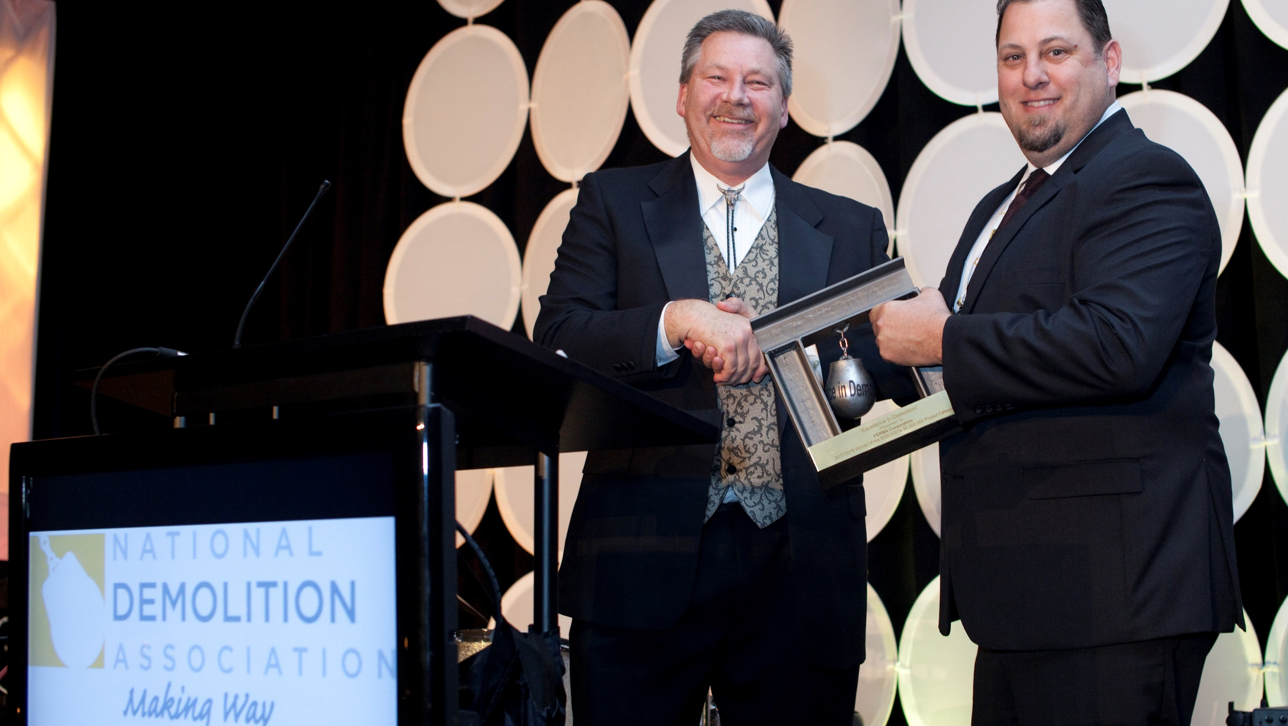
Company Title
General Information/ introduction of the project and why it is unique/special
Use the next two boxes to address the components of the award: Sustainability, Community Enhancement, Environmental Enterprise, Education, Pollution Prevention and Resource Conservation, Special Project Considerations. Only comment on what applies to your project. Your project should address at least one (1) of the below components.
Sustainability A significant portion of your project involved implementing proper processes that use resources efficiently, did not generate hazardous wastes and promoted beneficial reuse and recycling of building components and material. This would include material management for recycling of materials that could be used in the future..
Community Enhancement
The project recognized the need to support the local community by involvement, enhancement, including economic development by use of local workforce and training, local use of commerce and materials.
Environmental Enterprise
The work pertained to the development and implementation of unique and innovative solutions that provide significant environmental and social benefit. Consider technical feasibility and commercial viability.
Education
The work involved developing educational programs for the local
community and extended beyond those associated with specification compliance programs. Conducted outreach to the local community and provided vocational training for long term employment. Provided an open forum for the public to learn the benefits and aspects of the demolition Industry.
Pollution Prevention and Resource Conservation
Project implemented a comprehensive and formalized policy program, systems and procedures that extend beyond required compliance measures and was able to use resources wisely and train employees.
Special Project Considerations
Project implemented specialty innovations or circumstances that recognizes required innovation on the part of the contractor. Development of alternative methodologies that benefits the industry as a whole
Include a conclusion, high-level statistics about your project.
Company Tagline/ hi res logo

